Slide 1



MICROSOFT
MOVIE STUDIO
ANTHONY MANYURA
DVT03 PHASE-1-PROJECT

Slide 2



PROJET OVERVIEW
This project aims to leverage data analytics to identify high-performing movie genres and provide actionable insights for Microsoft's new movie studio. We aim to inform strategic decision-making in film production by analyzing box office data.

Slide 3



PROBLEM STATEMENT
Microsoft seeks to enter the competitive movie industry but lacks insights into successful film genres. This project addresses the critical need to identify profitable movie categories to inform the studio's content strategy.

Slide 4
OBJECTIVES
Analyze box office performance across different movie genres.
Identify genres with high domestic and foreign gross revenue.
Evaluate the relationship between movie runtime and box office performance.
Understand the distribution of average ratings across genres

Slide 5
ANALYSIS TOOLS
Data was collected and processed using Python programming language.
Pandas library was employed for data manipulation and cleaning.
Matplotlib and Seaborn were utilized for data visualization.
Exploratory data analysis (EDA) techniques were applied to uncover patterns and trends.

Slide 6
ANALYSIS PROCESS
Data was collected on movie titles, genres, domestic and foreign gross revenue, runtime, and average ratings.
Exploratory data analysis was conducted to examine the distribution of genres, box office performance, and runtime.
Visualizations were created to illustrate key findings and relationships between variables.

Slide 7
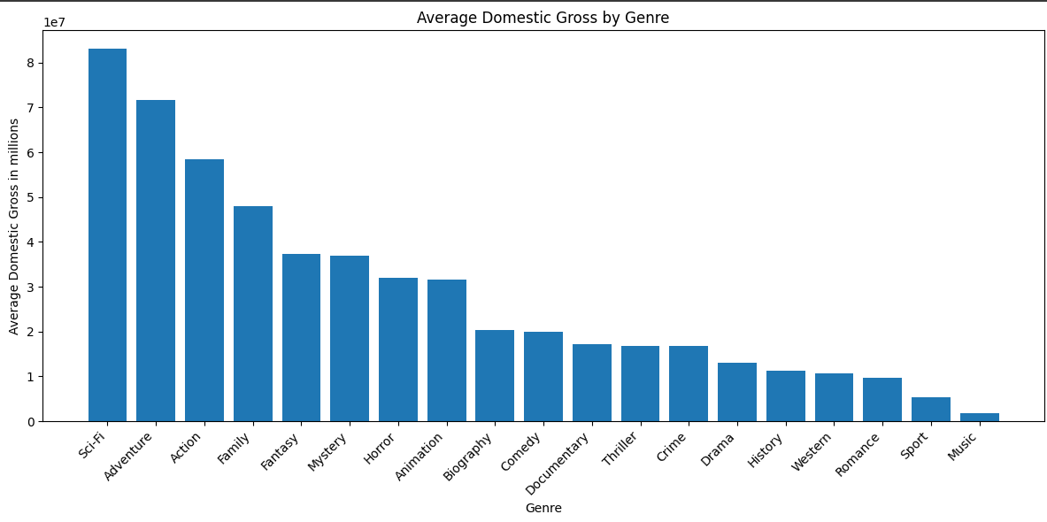
DATA VISUALIZATIONS

Slide 8
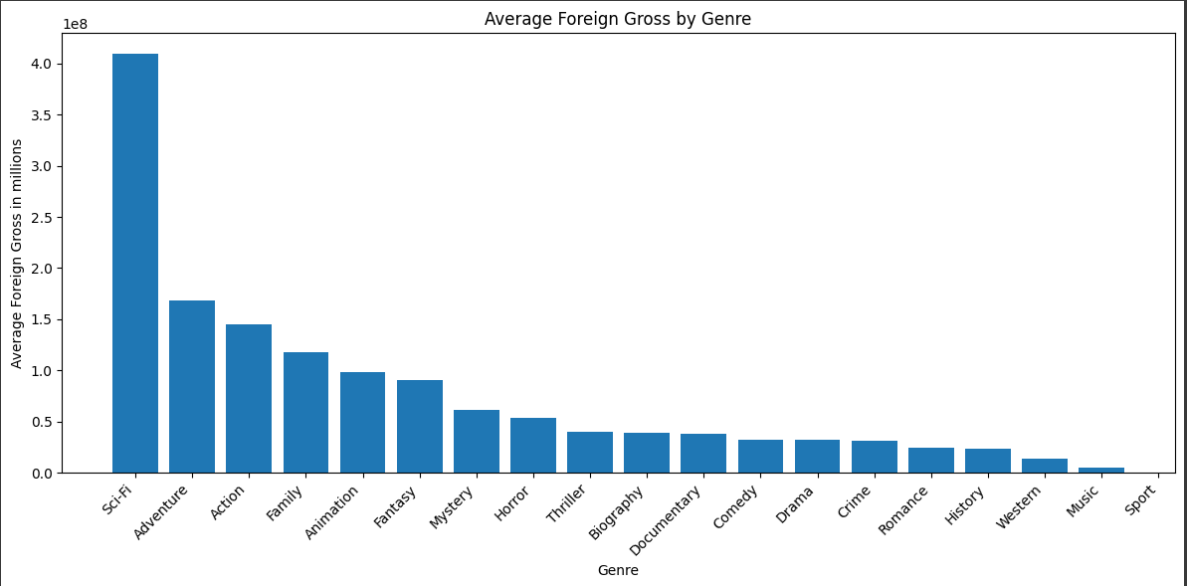
DATA VISUALIZATIONS

Slide 9
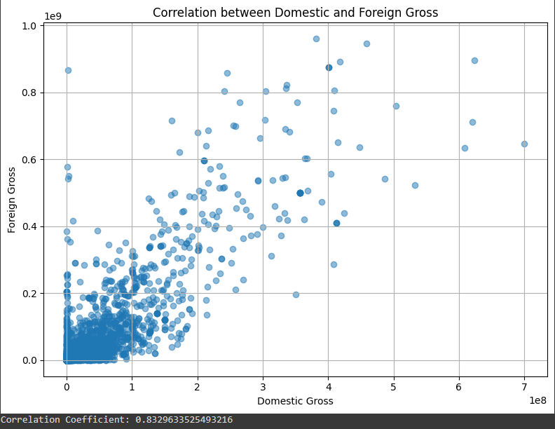
DATA VISUALIZATIONS

Slide 10
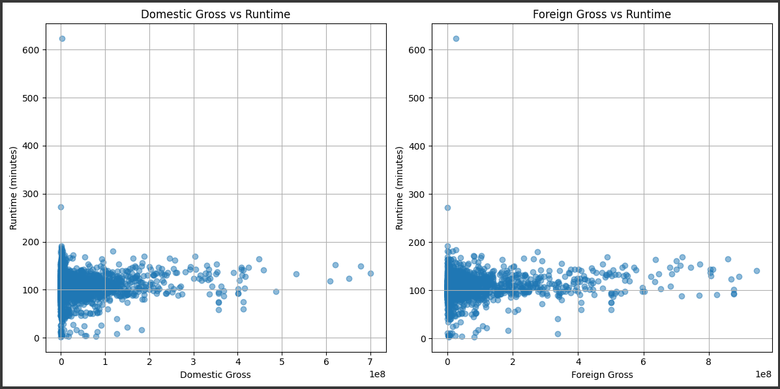
DATA VISUALIZATIONS

Slide 11
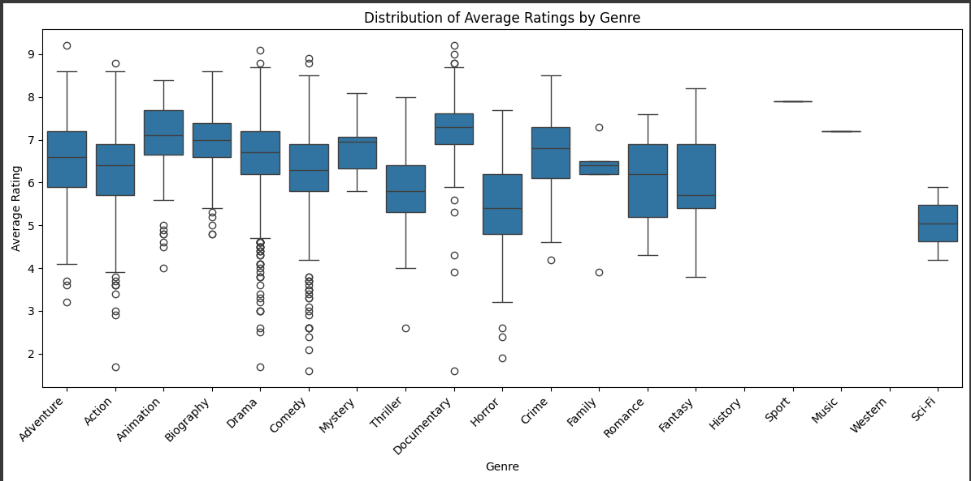
DATA VISUALIZATIONS

Slide 12
FINDINGS
Key Findings
Genre is a key driver of box office success. Sci-Fi, Adventure, and Action consistently outperform other genres in both domestic and foreign markets.
Movie runtime has a negligible impact on revenue. Other factors such as genre, star power, and marketing play a more significant role.

Slide 13
FINDINGS
Recommendations
Prioritize Sci-Fi, Adventure, and Action genres for both domestic and foreign releases.
Explore genre diversification within these high-performing categories to reach broader audiences.
Conduct in-depth analysis on specific sub-genres and target audiences to optimize market penetration.

Slide 14
CONCLUSION
By leveraging data analytics, we've identified key factors influencing box office success. Focusing on genres like Sci-Fi, Adventure, and Action can significantly enhance a studio's revenue. While runtime appears less critical, a deeper dive into audience preferences and market trends is essential for sustained success.
To maximize profitability, focus on the mentioned genres while considering audience preferences and market trends.

